Slide 1
DATA MINING & MACHINE LEARNING: Classification
Fosca Giannotti
Revisited slides from Lecture Notes for Chapter 7 “Introduction to Data Mining”, 2nd Edition by Tan, Steinbach, Karpatne, Kumar

Slide 2

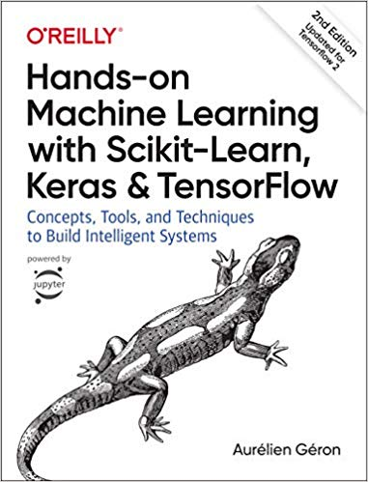
References
Chapter 7 “Introduction to Data Mining”,
Hands-on Machine Learning with Scikit-Learn, Keras & Tensorflow. A practical handbook to start wrestling with Machine Learning models (2nd ed).

Slide 3
Model Evaluation

Slide 4
Model Evaluation
Metrics for Performance Evaluation
How to evaluate the performance of a model?
Methods for Performance Evaluation
How to obtain reliable estimates?
Methods for Model Comparison
How to compare the relative performance among competing models?

Slide 5
Model Evaluation

Slide 6
Model Evaluation
Metrics for Performance Evaluation
How to evaluate the performance of a model?
Methods for Performance Evaluation
How to obtain reliable estimates?
Methods for Model Comparison
How to compare the relative performance among competing models?

Slide 7
Model Evaluation
Metrics for Performance Evaluation
How to evaluate the performance of a model?
Methods for Performance Evaluation
How to obtain reliable estimates?
Methods for Model Comparison
How to compare the relative performance among competing models?

Slide 8
Metrics for Performance Evaluation
Focus on the predictive capability of a model
Rather than how fast it takes to classify or build models, scalability, etc.
Confusion Matrix:
 | PREDICTED CLASS
ACTUAL CLASS |  | Class=Yes | Class=No
 | Class=Yes | a | b
 | Class=No | c | d
a: TP (true positive)
b: FN (false negative)
c: FP (false positive)
d: TN (true negative)

Slide 9
Metrics for Performance Evaluation…
 | PREDICTED CLASS
ACTUAL CLASS |  | Class=Yes | Class=No
 | Class=Yes | a (TP) | b (FN)
 | Class=No | c (FP) | d (TN)
Most widely-used metric:

Slide 10
Metrics for Performance Evaluation…
Class-Dependent Metrics:
 | PREDICTED CLASS
ACTUAL CLASS |  | Class=Yes | Class=No
 | Class=Yes | a (TP) | b (FN)
 | Class=No | c (FP) | d (TN)
Notes:
F-measure è la media armonica, una nozione di media pessimistica, si avvicina più al valore inferiore

Slide 11
Limitation of Accuracy
Consider a 2-class problem
Number of Class 0 examples = 9990
Number of Class 1 examples = 10
If model predicts everything to be class 0, accuracy is 9990/10000 = 99.9 %
Accuracy is misleading because model does not detect any class 1 example

Slide 12
Cost Matrix
 | PREDICTED CLASS
ACTUAL CLASS | C(i|j) | Class=Yes | Class=No
 | Class=Yes | C(Yes|Yes) | C(No|Yes)
 | Class=No | C(Yes|No) | C(No|No)
C(i|j): Cost of misclassifying class j example as class i

Slide 13
Computing Cost of Classification
Cost Matrix | PREDICTED CLASS
ACTUAL CLASS | C(i|j) | + | -
 | + | -1 | 100
 | - | 1 | 0
Model M₁ | PREDICTED CLASS
ACTUAL CLASS |  | + | -
 | + | 150 | 40
 | - | 60 | 250
Model M₂ | PREDICTED CLASS
ACTUAL CLASS |  | + | -
 | + | 250 | 45
 | - | 5 | 200
Accuracy = (150+250)/ 500 = 80%
Cost = 150*(-1) + 40*100+60+0=3910
Accuracy = (250+200)/500 =90%
Cost = 4255

Slide 14
Cost vs Accuracy
Accuracy is proportional to cost if 1. C(Yes|No)=C(No|Yes) = q 2. C(Yes|Yes)=C(No|No) = p
Count | PREDICTED CLASS
ACTUAL CLASS |  | Class=Yes | Class=No
 | Class=Yes | a | b
 | Class=No | c | d
N = a + b + c + d
Accuracy = (a + d)/N
Cost = p (a + d) + q (b + c)
= p (a + d) + q (N – a – d)
= q N – (q – p)(a + d)
= N [q – (q-p) × Accuracy]
Cost | PREDICTED CLASS
ACTUAL CLASS |  | Class=Yes | Class=No
 | Class=Yes | p | q
 | Class=No | q | p

Slide 15
Cost-Sensitive Measures
Precision is biased towards C(Yes|Yes) & C(Yes|No)
Recall is biased towards C(Yes|Yes) & C(No|Yes)
F-measure is biased towards all except C(No|No)

Slide 16
Fraud detection and audit planning
Source: Ministero delle Finanze
Progetto Sogei, KDD Lab. Pisa

Slide 17
Fraud detection
A major task in fraud detection is constructing models of fraudulent behavior, for:
preventing future frauds (on-line fraud detection)
discovering past frauds (a posteriori fraud detection)
analyze historical audit data to plan effective future audits

Slide 18
Audit planning
Need to face a trade-off between conflicting issues:
maximize audit benefits: select subjects to be audited to maximize the recovery of evaded tax
minimize audit costs: select subjects to be audited to minimize the resources needed to carry out the audits.

Slide 19
Available data sources
Dataset: tax declarations, concerning a targeted class of Italian companies, integrated with other sources:
social benefits to employees, official budget documents, electricity and telephone bills.
Size: 80 K tuples, 175 numeric attributes.
A subset of 4 K tuples corresponds to the audited companies:
outcome of audits recorded as the recovery attribute (= amount of evaded tax ascertained )

Slide 20
Data preparation
original
dataset
81 K
data consolidation
data cleaning
attribute selection
audit
outcomes
4 K

Slide 21
Cost model
A derived attribute audit_cost is defined as a function of other attributes
f
audit_cost

Slide 22
Cost model and the target variable
recovery of an audit after the audit cost actual_recovery = recovery - audit_cost
target variable (class label) of our analysis is set as the Class of Actual Recovery (c.a.r.):
negative if actual_recovery ≤ 0
c.a.r. =
positive if actual_recovery > 0.

Slide 23
Quality assessment indicators
The obtained classifiers are evaluated according to several indicators, or metrics
Domain-independent indicators
confusion matrix
misclassification rate
Domain-dependent indicators
audit #
actual recovery
profitability
relevance

Slide 24
Domain-dependent quality indicators
audit # (of a given classifier): number of tuples classified as positive = # (FP ∪ TP)
actual recovery: total amount of actual recovery for all tuples classified as positive
profitability: average actual recovery per audit
relevance: ratio between profitability and misclassification rate

Slide 25
The REAL case
Classifiers can be compared with the REAL case, consisting of the whole test-set:
audit # (REAL) = 366
actual recovery(REAL) = 159.6 M euro

Slide 26
Model evaluation: classifier 1 (min FP)
no replication in training-set (unbalance towards negative)
10-trees adaptive boosting
misc. rate = 22%
audit # = 59 (11 FP)
actual rec.= 141.7 Meuro
profitability = 2.401

Slide 27
Model evaluation: classifier 2 (min FN)
replication in training-set (balanced neg/pos)
misc. weights (trade 3 FP for 1 FN)
3-trees adaptive boosting
misc. rate = 34%
audit # = 188 (98 FP)
actual rec.= 165.2 Meuro
profitability = 0.878

Slide 28
Model Evaluation
Metrics for Performance Evaluation
How to evaluate the performance of a model?
Methods for Performance Evaluation
How to obtain reliable estimates?
Methods for Model Comparison
How to compare the relative performance among competing models?

Slide 29
Methods for Evaluation
Training Set
model fit
Classifier
Dataset
X_{train}
Model
Learning
f
X
Y_{train}
Y
X_{test}
Model
Application
model
predict
Y_{test}
Test Set
Model
Evaluation
Y_{pred}
Prediction

Slide 30
Parameter Tuning
It is important that the test data is not used in any way to create the classifier
Some learning schemes operate in two stages:
Stage 1: builds the basic structure
Stage 2: optimizes parameter settings
The test data can’t be used for parameter tuning!
Proper procedure uses three sets:
training data,
validation data,
test data
Validation data is used to optimize parameters
Once evaluation is complete, all the data can be used to build the final classifier
Generally, the larger the training data the better the classifier
The larger the test data the more accurate the error estimate

Slide 31
Data Partitioning
Dataset
Train
Test
Holdout (e.g.70/30)
Train the model for final testing
Train
Validation
Test
Train the model for parameter selection
Validate the model (early stopping, parameter selection, etc.)
Test the model
Compare different models once parameters have been selected
Test
Cross Validation (check potential dataset bias)

Slide 32
Methods for Performance Evaluation
How to obtain a reliable estimate of performance?
Performance of a model may depend on other factors besides the learning algorithm:
Class distribution
Cost of misclassification
Size of training and test sets

Slide 33
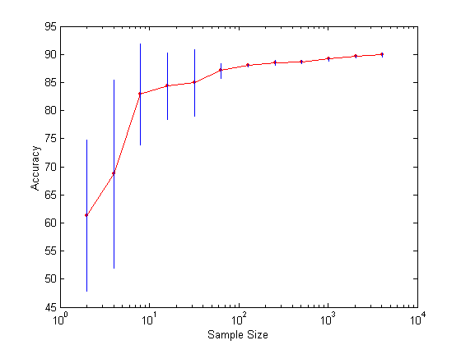
Learning Curve
Learning curve shows how accuracy changes with varying sample size
Requires a sampling schedule for creating learning curve:
Effect of small sample size:
Bias in the estimate
Variance of estimate
How much a classification model benefits from adding more training data?
Does the model suffer from a variance error or a bias error?

Slide 34
Methods of Estimation
Holdout
Reserve 2/3 for training and 1/3 for testing
Random subsampling
Repeated holdout
Cross validation
Partition data into k disjoint subsets
k-fold: train on k-1 partitions, test on the remaining one
Leave-one-out: k=n
Stratified sampling
oversampling vs undersampling
Bootstrap
Sampling with replacement

Slide 35
Small & Unbalanced Data
The holdout method reserves a certain amount for testing and uses the remainder for training
Usually, one third for testing, the rest for training
For small or “unbalanced” datasets, samples might not be representative
For instance, few or none instances of some classes
Stratified sample
Balancing the data
Make sure that each class is represented with approximately equal proportions in both subsets

Slide 36
Repeated holdout method
Holdout estimate can be made more reliable by repeating the process with different subsamples
In each iteration, a certain proportion is randomly selected for training (possibly with stratification)
The error rates on the different iterations are averaged to yield an overall error rate
This is called the repeated holdout method
Still not optimum: the different test sets overlap

Slide 37
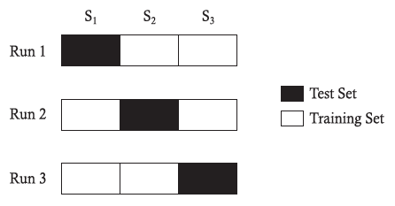
Cross Validation
Avoids overlapping test sets
First step: data is split into k subsets of equal size
Second step: each subset in turn is used for testing and the remainder for training
This is called k-fold cross-validation
Often the subsets are stratified before cross-validation is performed
The error estimates are averaged to yield an overall error estimate
Even better: repeated stratified cross-validation E.g. ten-fold cross-validation is repeated ten times and results are averaged (reduces the variance)

Slide 38
Model Evaluation
Metrics for Performance Evaluation
How to evaluate the performance of a model?
Methods for Performance Evaluation
How to obtain reliable estimates?
Methods for Model Comparison
How to compare the relative performance among competing models?

Slide 39
ROC (Receiver Operating Characteristic)
Developed in 1950s for signal detection theory to analyze noisy signals
Characterize the trade-off between positive hits and false alarms
ROC curve plots TP (on the y-axis) against FP (on the x-axis)
Performance of each classifier represented as a point on the ROC curve
changing the threshold of algorithm, sample distribution or cost matrix changes the location of the point

Slide 40
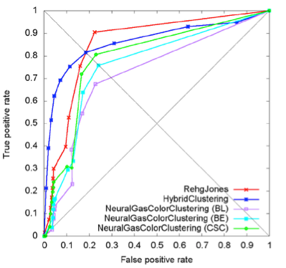
Receiver Operating Characteristic Curve
It illustrates the ability of a binary classifier as its discrimination threshold THR is varied.
The ROC curve is created by plotting the true positive rate (TPR) against the false positive rate (FPR) at various THR.
The TPR = TP / (TP + FN) is also known as sensitivity, recall or probability of detection.
The FPR = FP / (TN + FP) is also known as probability of false alarm and can be calculated as (1 − specificity).
https://towardsdatascience.com/understanding-auc-roc-curve-68b2303cc9c5

Slide 41
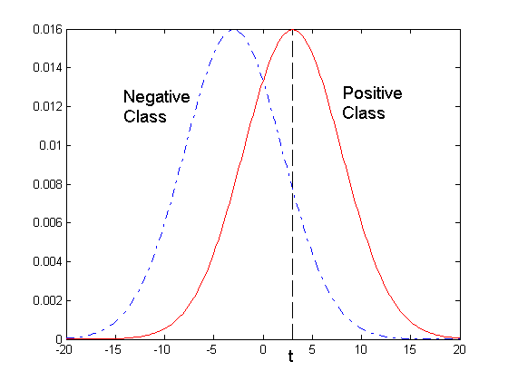
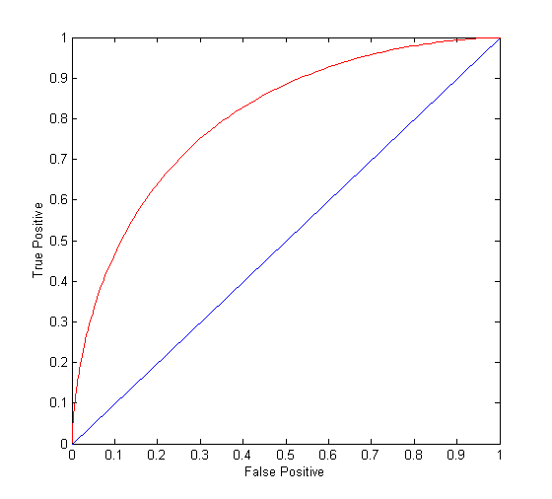
ROC Curve
- 1-dimensional data set containing 2 classes (positive and negative)
- any points located at x > t is classified as positive
At threshold t:
TP=0.5, FN=0.5, FP=0.12, FN=0.88

Slide 42
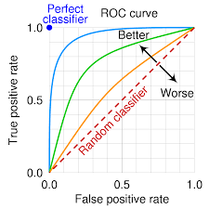
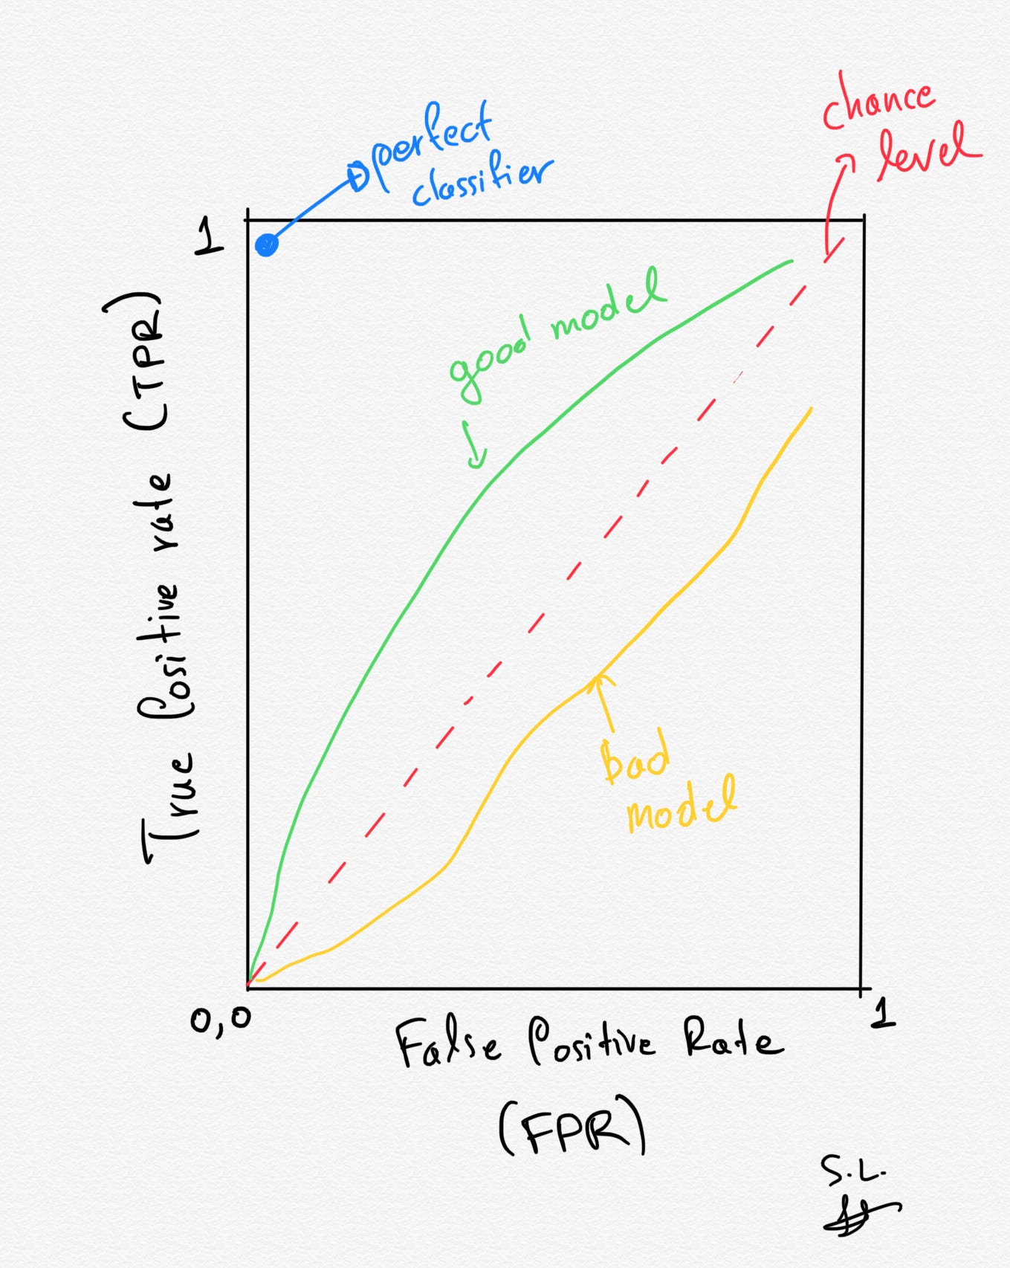

Slide 43
ROC Curve
(TPR,FPR):
(0,0): declare everything to be negative class
(1,1): declare everything to be positive class
(0,1): ideal
Diagonal line:
Random guessing
Below diagonal line:
prediction is opposite of the true class

Slide 44
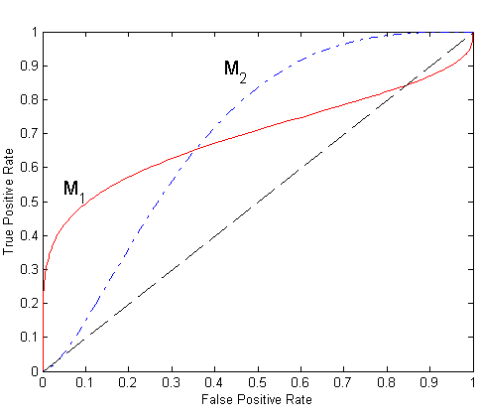
Using ROC for Model Comparison
No model consistently outperform the other
M₁ is better for small FPR
M₂ is better for large FPR
Area Under the ROC curve
Ideal:
Area = 1
Random guess:
Area = 0.5

Slide 45
How to Construct the ROC curve
Use classifier that produces posterior probability for each test instance P(+|A)
Sort the instances according to P(+|A) in decreasing order
Apply threshold at each unique value of P(+|A)
Count the number of TP, FP, TN, FN at each threshold
TP rate, TPR = TP/(TP+FN)
FP rate, FPR = FP/(FP + TN)
Instance | P(+|A) | True Class
1 | 0.95 | +
2 | 0.93 | +
3 | 0.87 | -
4 | 0.85 | -
5 | 0.85 | -
6 | 0.85 | +
7 | 0.76 | -
8 | 0.53 | +
9 | 0.43 | -
10 | 0.25 | +

Slide 46
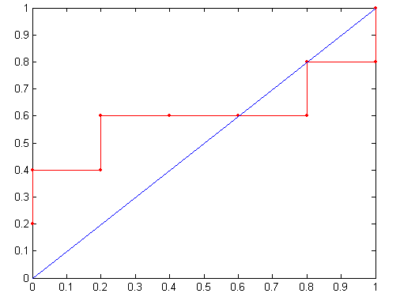
How to Construct the ROC curve
Threshold >=
Inst. | P(+|A) | True Class
1 | 0.95 | +
2 | 0.93 | +
3 | 0.87 | -
4 | 0.85 | -
5 | 0.85 | -
6 | 0.85 | +
7 | 0.76 | -
8 | 0.53 | +
9 | 0.43 | -
10 | 0.25 | +
ROC Curve:

Slide 47
Test of Significance
Given two models:
Model M1: accuracy = 85%, tested on 30 instances
Model M2: accuracy = 75%, tested on 5000 instances
Can we say M1 is better than M2?
How much confidence can we place on accuracy of M1 and M2?
Can the difference in performance measure be explained as a result of random fluctuations in the test set?

Slide 48
Confidence Interval for Accuracy
Prediction can be regarded as a Bernoulli trial (binomial random experiment)
A Bernoulli trial has 2 possible outcomes
Possible outcomes for prediction: correct or wrong
Probability of success is constant
Collection of Bernoulli trials has a Binomial distribution:
x ∼ Bin(N, p) x: # of correct predictions, N trials, p constant prob.
e.g: Toss a fair coin 50 times, how many heads would turn up? Expected number of heads = N×p = 50 × 0.5 = 25
Given x (# of correct predictions) or equivalently, acc=x/N, and N (# of test instances)
Can we predict p (true accuracy of model)?

Slide 49
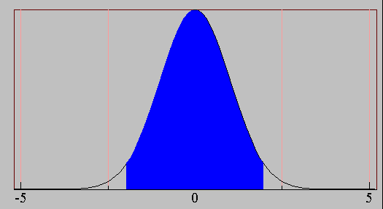
Confidence Interval for Accuracy
Area = 1 - α
For large test sets (N > 30),
acc has a normal distribution with mean p and variance p(1-p)/N
Confidence Interval for p:
Z_{α/2}
Z_{1- α /2}
Notes:
where Zα/2 and Z1−α/2 are the upper and lower bounds obtained from a standard normal distribution at confidence level (1 − α).
Since a standard normal distribution is symmetric around Z = 0, it follows that Zα/2 = Z1−α/2 then we have the interval for P

Slide 50
Confidence Interval for Accuracy
Consider a model that produces an accuracy of 80% when evaluated on 100 test instances:
N=100, acc = 0.8
Let 1-α = 0.95 (95% confidence)
Which is the confidence interval?
From probability table, Z_{α/2}=1.96
1-α | Z
0.99 | 2.58
0.98 | 2.33
0.95 | 1.96
0.90 | 1.65
N | 50 | 100 | 500 | 1000 | 5000
p(lower) | 0.670 | 0.711 | 0.763 | 0.774 | 0.789
p(upper) | 0.888 | 0.866 | 0.833 | 0.824 | 0.811
Notes:
Inserting this term into Equation 4.13 yields a confidence interval between 71.1% and 86.7%.

Slide 51
Comparing Performance of 2 Models
Given two models, say M1 and M2, which is better?
M1 is tested on D1 (size=n1), found error rate = e₁
M2 is tested on D2 (size=n2), found error rate = e₂
Assume D1 and D2 are independent
If n1 and n2 are sufficiently large, then
Approximate variance of error rates:

Slide 52
Comparing Performance of 2 Models
To test if performance difference is statistically significant: d = e₁ – e₂
d ~ N(d_{t},σ_{t}) where d_{t} is the true difference
Since D1 and D2 are independent, their variance adds up:
It can be shown at (1-α) confidence level,

Slide 53
An Illustrative Example
Given: M1: n1 = 30, e1 = 0.15 M2: n2 = 5000, e2 = 0.25
d = |e2 – e1| = 0.1 (2-sided test to check: dt = 0 or dt <> 0)
At 95% confidence level, Z_{α/2}=1.96 => Interval contains 0 => difference may not be statistically significant

Slide 54
Comparing Performance of 2 Algorithms
Each learning algorithm may produce k models:
L1 may produce M11 , M12, …, M1k
L2 may produce M21 , M22, …, M2k
If models are generated on the same test sets D1,D2, …, Dk (e.g., via cross-validation)
For each set: compute d_{j} = e_{1j} – e_{2j}
d_{j} has mean d_{t} and variance σ_{t}²
Estimate:

Slide 55
Ensemble Methods

Slide 56
Ensemble Methods
Improves the accuracy by aggregating the predictions of multiple classifiers.
Construct a set of base classifiers from the training data.
Predict class label of test records by combining the predictions made by multiple classifiers.
Notes:
Explainable-AI explores and investigates methods to produce or complement AI models to make accessible and interpretable the internal logic and the outcome of the algorithms, making such process understandable by humans.
Explicability, understood as incorporating both intelligibility (“how does it work?”) for non-experts, e.g., patients or business customers, and for experts, e.g., product designers or engineers) and accountability (“who is responsible for”).

Slide 57
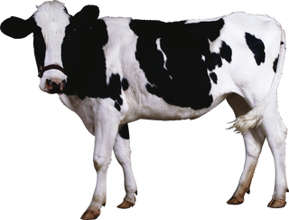
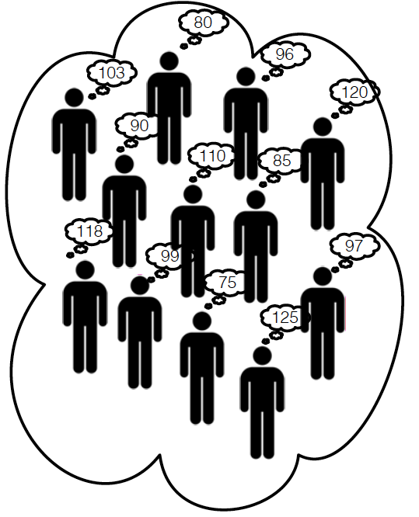
The Wisdom of the Crowds
The collective knowledge of a diverse and independent body of people typically exceeds the knowledge of any single individual and can be harnessed by voting.
How much does the cow weigh?
Crowd’s prediction is the average of all predictions.
This crowd predicts 99.8333 Kg
The cow weighs 99.657 Kg.

Slide 58
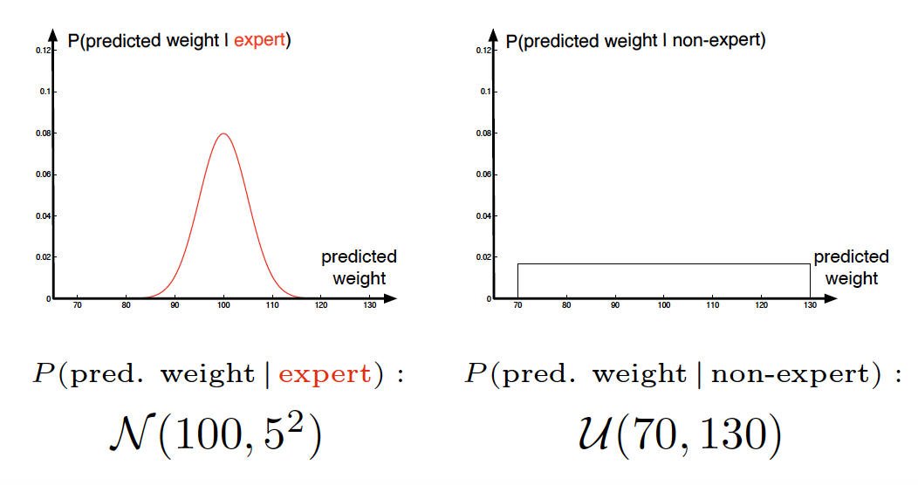
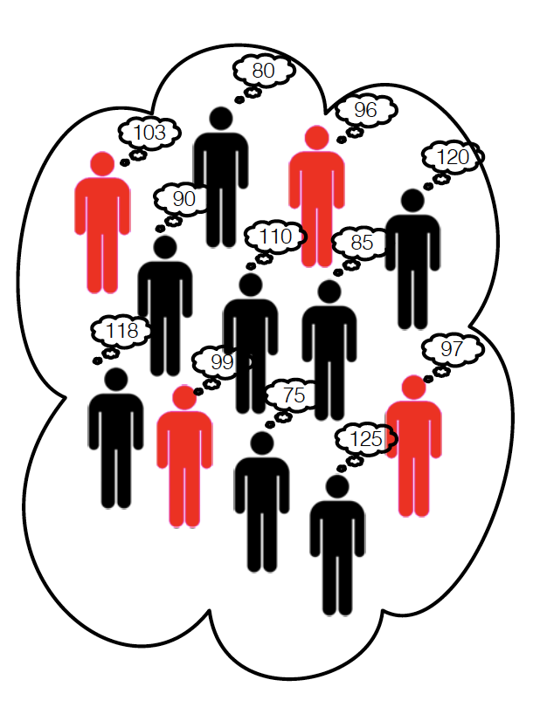
Has crowd made a good estimate?
If composition of crowd:
30% experts.
70% non-experts.
and their level of expertise:

Slide 59
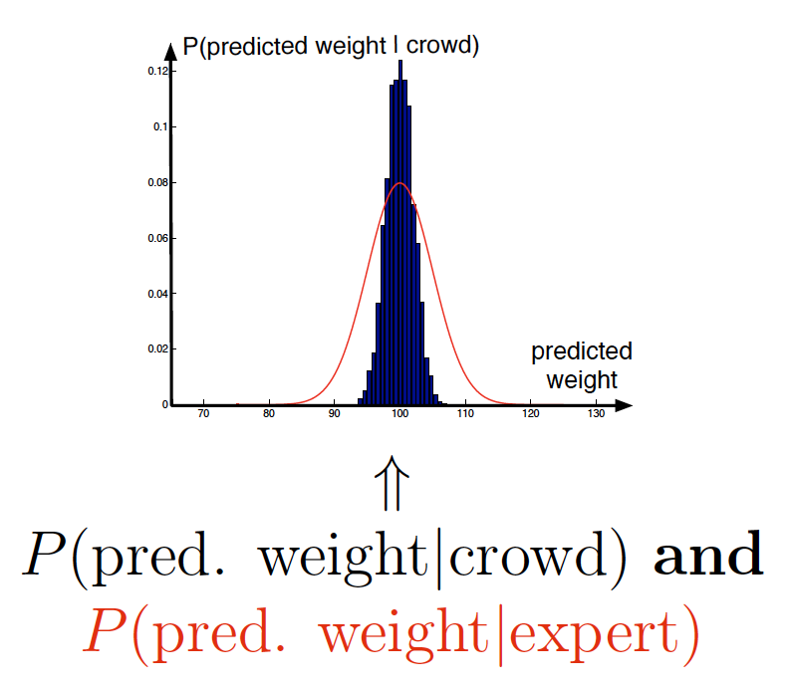
Has crowd made a good estimate?
If the crowd contains 50 independent people:
On average this crowd will make better estimates than the experts.
Thus the crowd wiser than each of the experts!

Slide 60
Why didn’t I just asked a bunch of experts?
Large enough crowd → high probability a sufficient number of experts will be in crowd (for any question).
Random selection → don’t make a biased choice in experts.
For some questions it may be hard to identify a diverse set of experts.

Slide 61
What makes a crowd wise?
According to James Surowiecki there are four elements required to form a wise crowd
Diversity of opinion. People in crowd should have a range of experiences, education and opinions (this encourages independent predictions).
Independence. Prediction by person in crowd is not influenced by other people in the crowd.
Decentralization. People have specializations and local knowledge.
Aggregation. There is a mechanism for aggregating all predictions into one single prediction.

Slide 62
Back to Machine Learning
It will exploit Wisdom of crowd ideas for specific tasks
By combining classifier predictions and
aims to combine independent and diverse classifiers.
But it will use labelled training data
to identify the expert classifiers in the pool;
to identify complementary classifiers;
to indicate how to the best combine them.

Slide 63
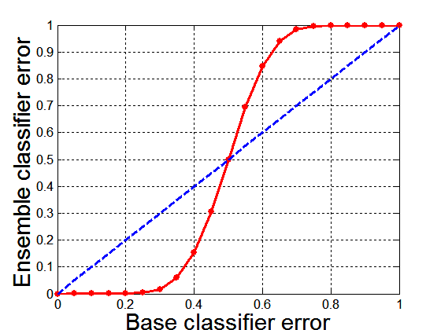
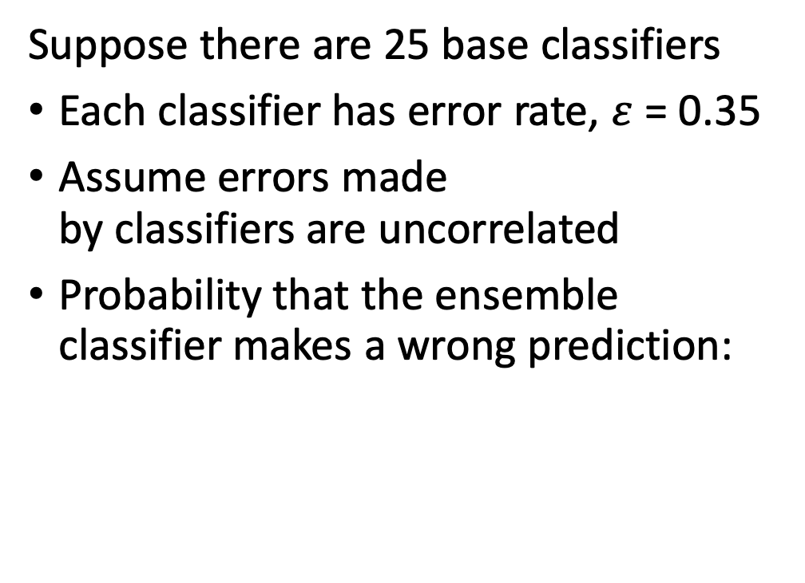
Why Ensemble Methods work?
Suppose there are 25 base classifiers
Each classifier has error rate, $ε$ = 0.35
Assume errors made by classifiers are uncorrelated
Probability that the ensemble classifier makes a wrong prediction:
Notes:
Diagonal dashed line represent the case in which the base classifiers are identical, the solid line the case in which are independent.

Slide 64
Types of Ensemble Methods
Manipulate data distribution
Example: bagging, boosting
Manipulate input features
Example: random forests
Manipulate class labels
Example: error-correcting output coding
Notes:
Manipulate data distribution: multiple trainign sets are created by resampling the original data according to soem sampling distribution.
The resampling distribution determines how likely is that an example will be selected for training, and it may vary from oen trial to another.
Manipulate input features: a subset of input features is chosen to from each training set. The subset can be either chosen randomly or not.

Slide 65
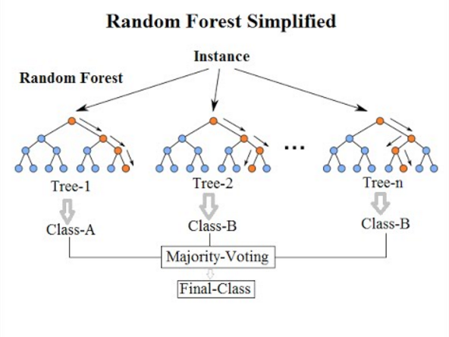
Random Forests : Manipulate input features
Is a class of ensemble methods specifically designed for decision trees.
It combines the predictions made by multiple decision trees and outputs the class that is the mode of the class's output by individual trees.

Slide 66
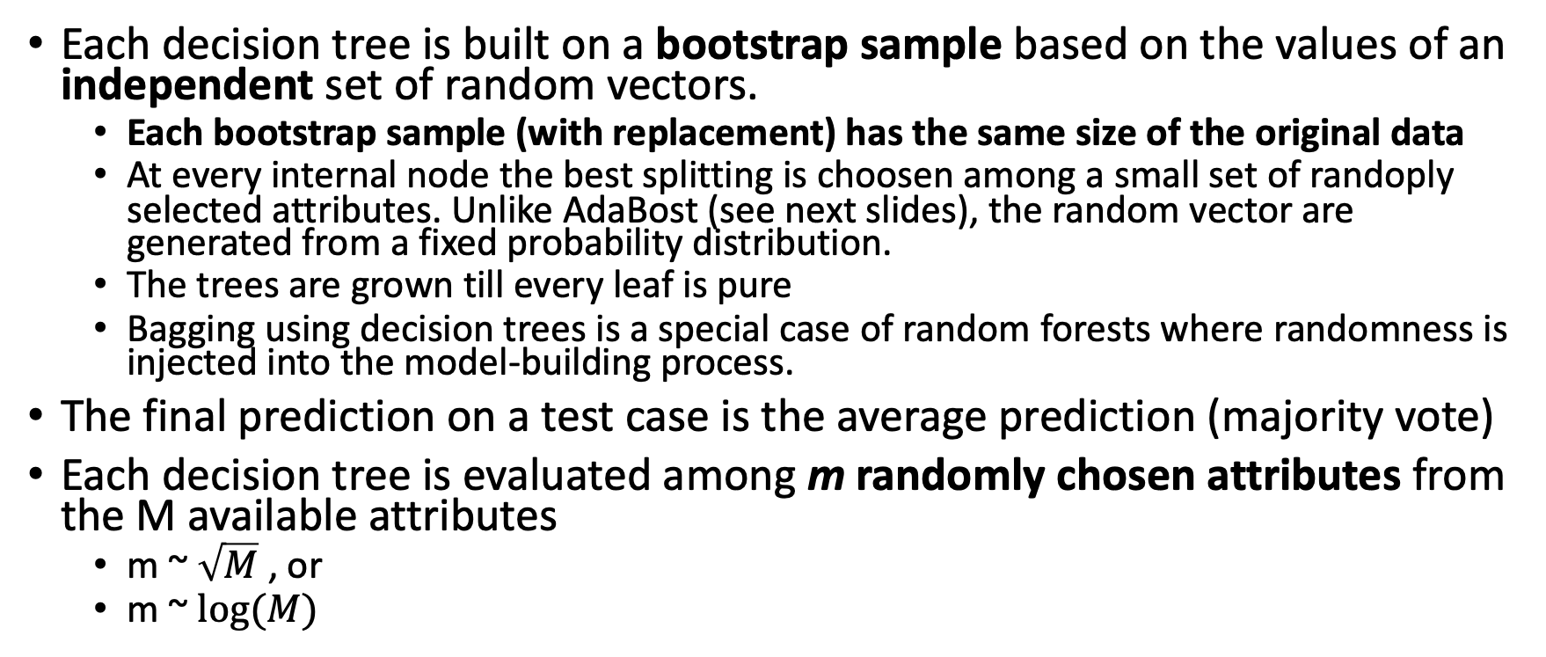
Random Forest
Each decision tree is built on a bootstrap sample based on the values of an independent set of random vectors.
Each bootstrap sample (with replacement) has the same size of the original data
At every internal node the best splitting is choosen among a small set of randoply selected attributes. Unlike AdaBost (see next slides), the random vector are generated from a fixed probability distribution.
The trees are grown till every leaf is pure
Bagging using decision trees is a special case of random forests where randomness is injected into the model-building process.
The final prediction on a test case is the average prediction (majority vote)
Each decision tree is evaluated among m randomly chosen attributes from the M available attributes
m ~ $\sqrt{M}$, or
m ~ $log⁡(M)$

Slide 67
Random Forest - Advantages
It is one of the most accurate learning algorithms available. For many data sets, it produces a high accurate classifier.
It runs efficiently on large databases.
It can handle thousands of input variables without variable deletion.
It gives estimates of what variables are important in the classification.
It generates an internal unbiased estimate of the generalization error as the forest building progresses.

Slide 68
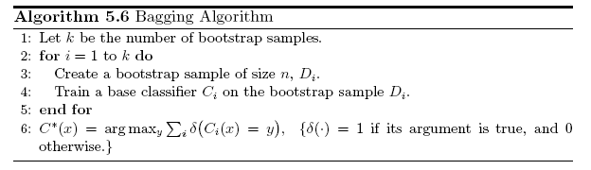
Bagging (a.k.a. Bootstrap AGGregatING)
Sampling with replacement
Build classifier on each bootstrap sample
Each sample has probability 1-(1 – 1/n)^{n} of being selected

Slide 69
Bagging Example
Consider 1-dimensional data set:
Classifier is a decision stump
Decision rule: x <= k versus x > k
Split point k is chosen based on entropy
x ≤ k
True
False
y_{left}
y_{right}

Slide 70
Bagging Example

Slide 71
Bagging Example

Slide 72
Bagging Example

Slide 73
Bagging Example
Summary of Training sets:

Slide 74
Bagging Example
Assume test set is the same as the original data
Use majority vote to determine class of ensemble classifier
Predicted Class

Slide 75
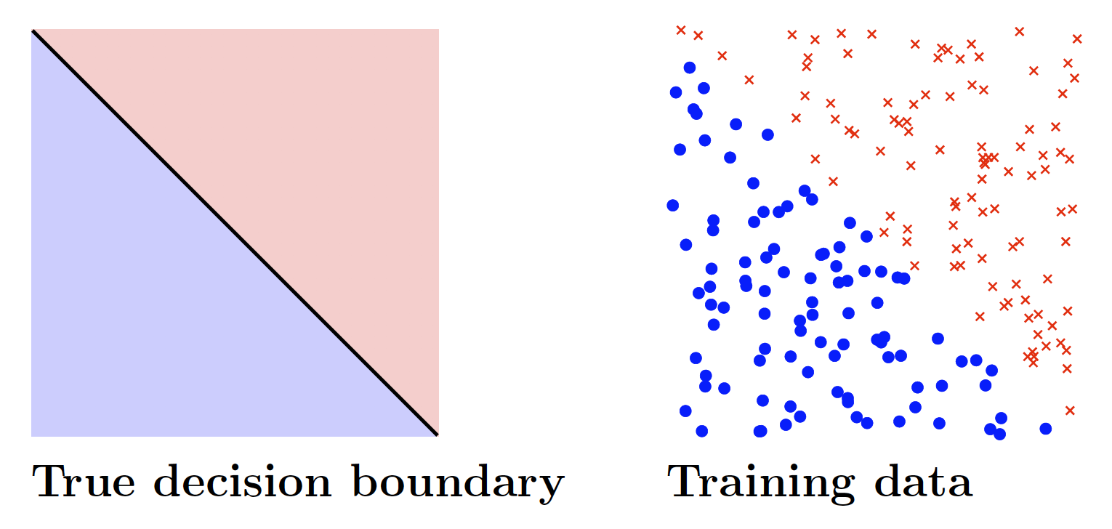
Bagging Visual Example

Slide 76
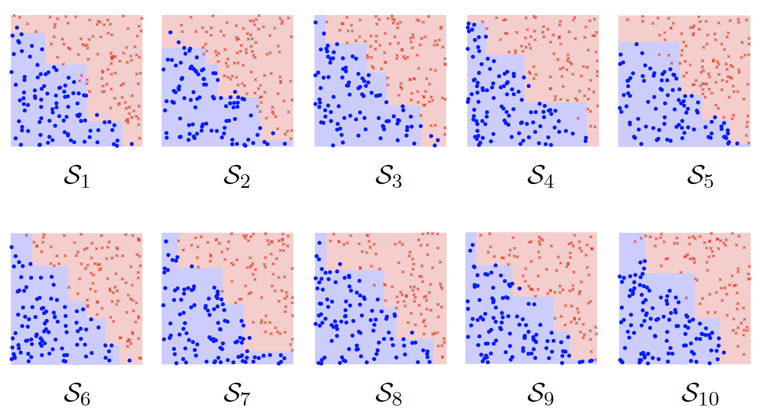
Bagging Visual Example

Slide 77
Boosting
An iterative procedure to adaptively change distribution of training data by focusing more on previously misclassified records.
Initially, all the records are assigned equal weights.
Unlike bagging, weights may change at the end of each boosting round.

Slide 78
Boosting
Records that are wrongly classified will have their weights increased.
Records that are classified correctly will have their weights decreased.
Example 4 is hard to classify
Its weight is increased, therefore it is more likely to be chosen again in subsequent rounds

Slide 79
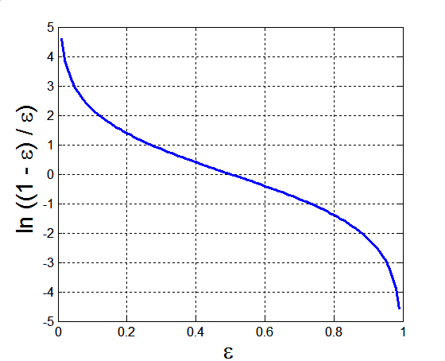
AdaBoost
Base classifiers: C₁, C₂, …, C_{T}
Error rate:
Importance of a classifier:
High positive importance when error is close to 0,
High negative importance when error is close to 1

Slide 80
AdaBoost Algorithm
Weight update:
Increases weights of incorrected classified examples & decreases weights of corrected classified examples
If any intermediate rounds produce error rate higher than 50%, the weights are reverted back to 1/n and the resampling procedure is repeated
Classification:
Weight associated to x_{i} during the j boosting round

Slide 81
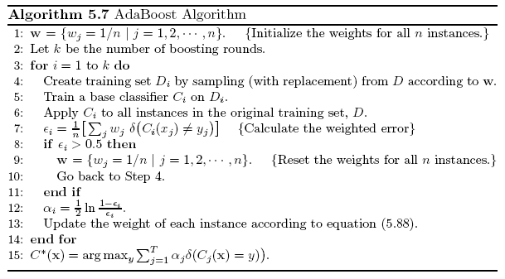
AdaBoost Algorithm

Slide 82
AdaBoost Example
Consider 1-dimensional data set:
Classifier is a decision stump
Decision rule: x ≤ k versus x > k
Split point k is chosen based on entropy
x ≤ k
True
False
y_{left}
y_{right}

Slide 83
AdaBoost Example
Training sets for the first 3 boosting rounds:
Weights:

Slide 84
AdaBoost Example
Summary:
Classification
Predicted Class

Slide 85
AdaBoost Visual Example

Slide 86
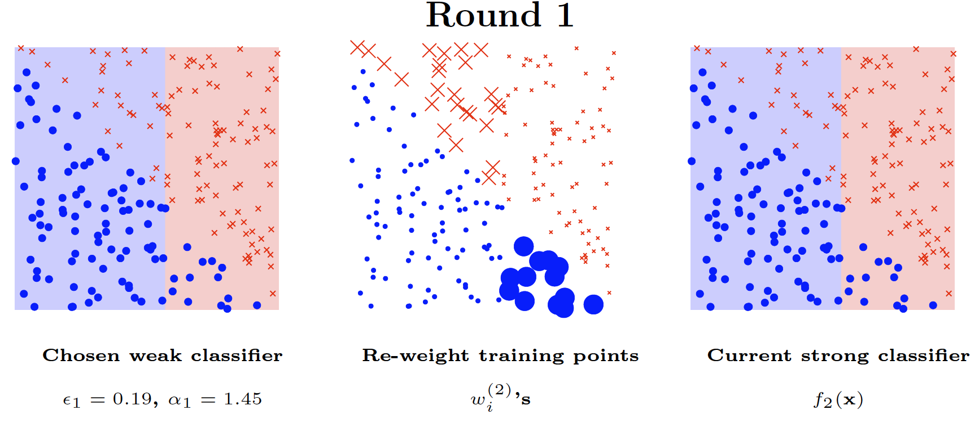
AdaBoost Visual Example

Slide 87
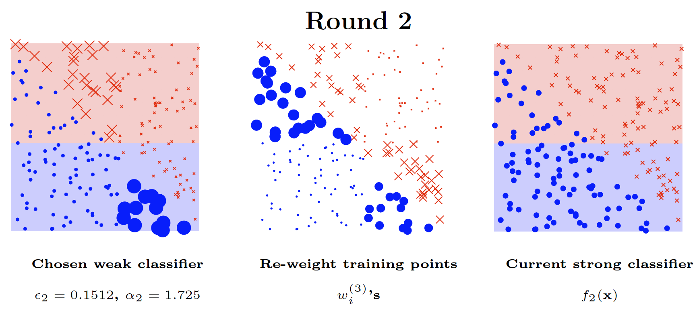
AdaBoost Visual Example

Slide 88
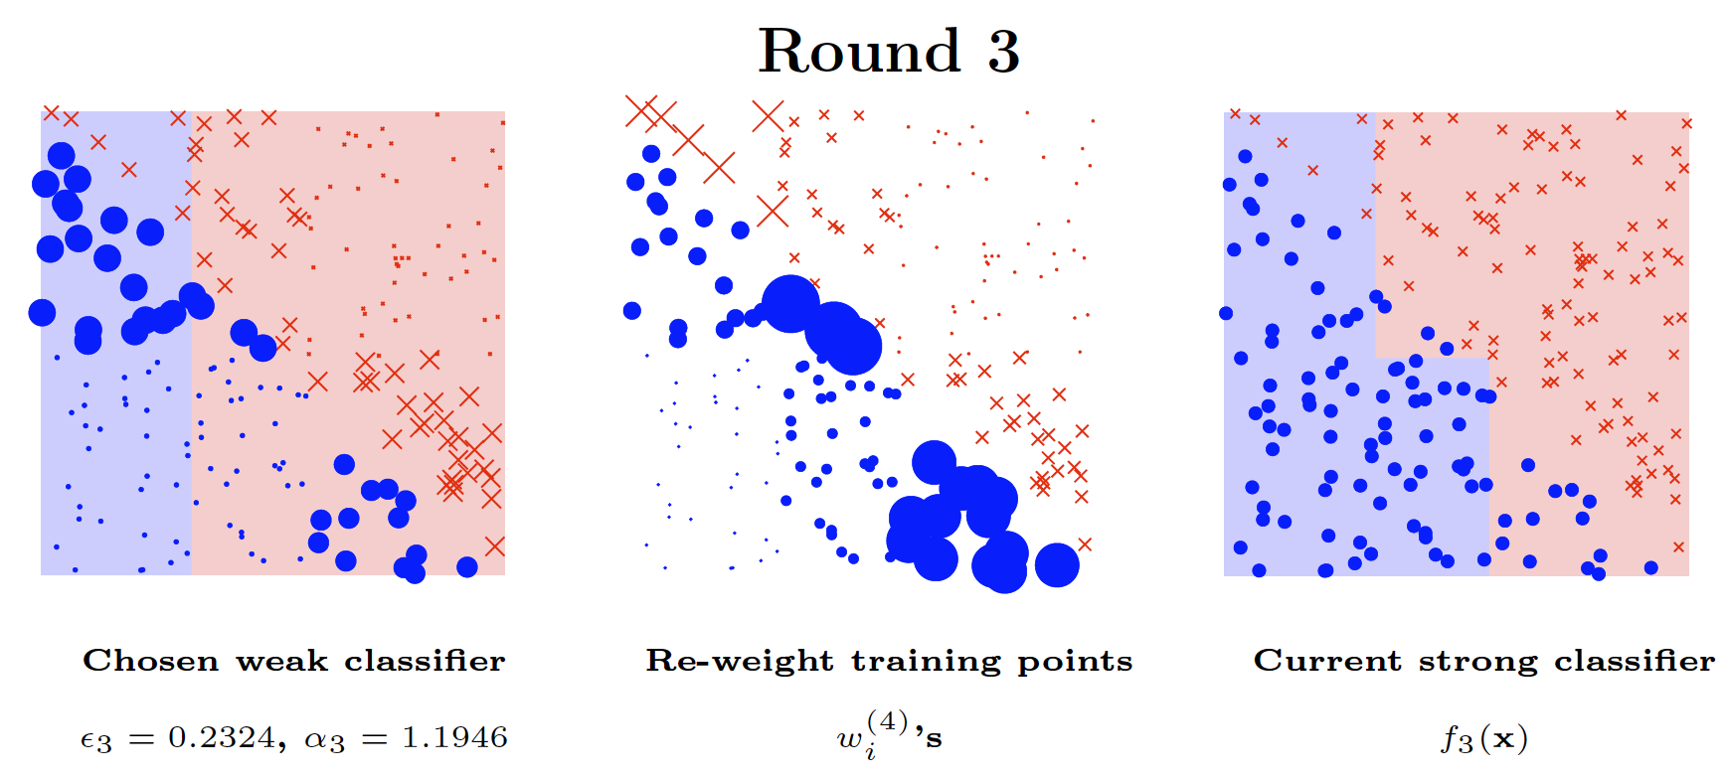
AdaBoost Visual Example

Slide 89
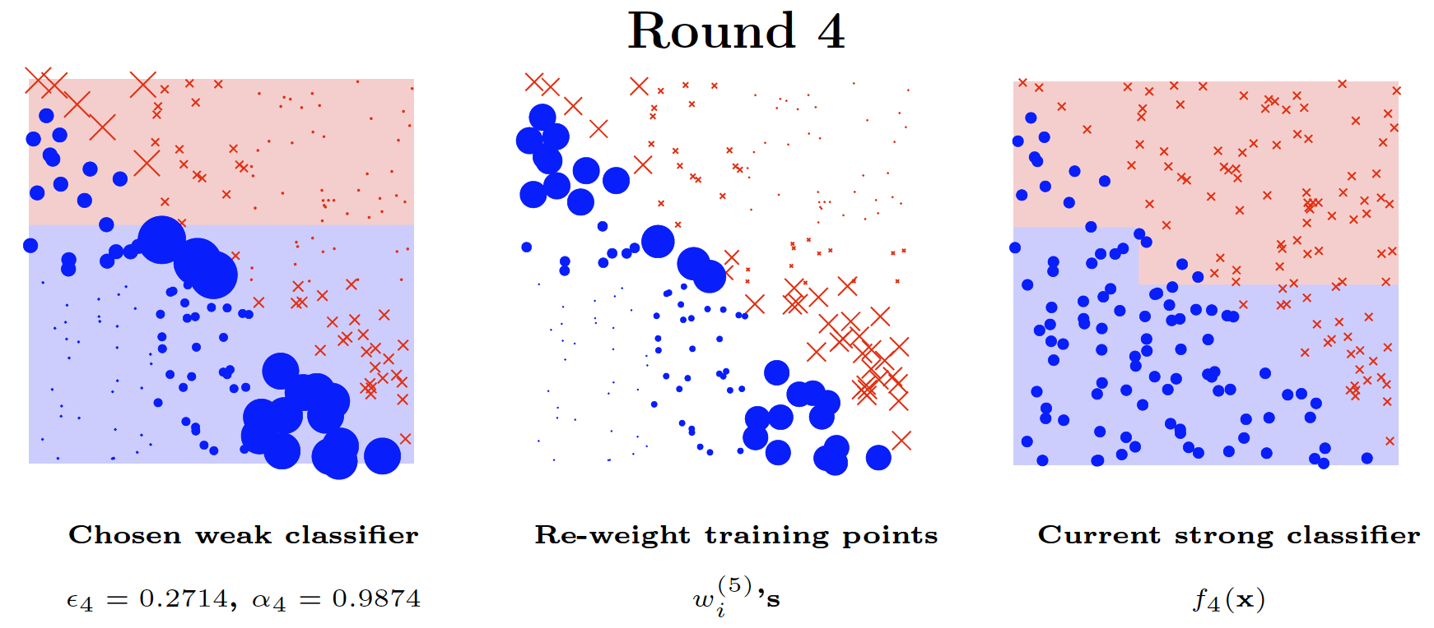
AdaBoost Visual Example

Slide 90
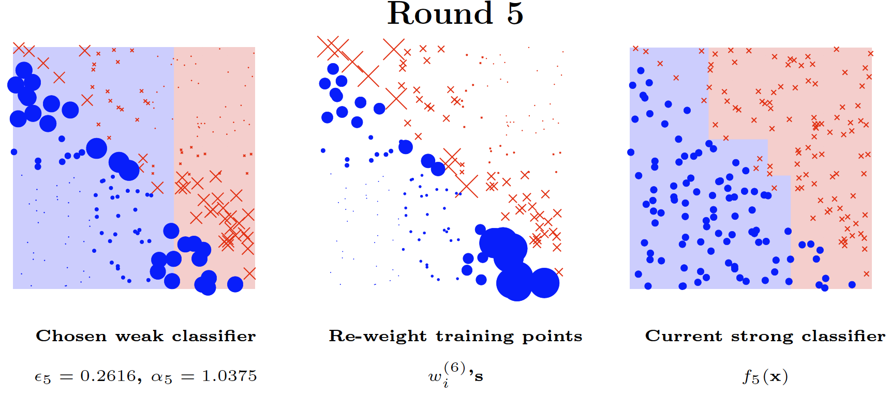
AdaBoost Visual Example

Slide 91
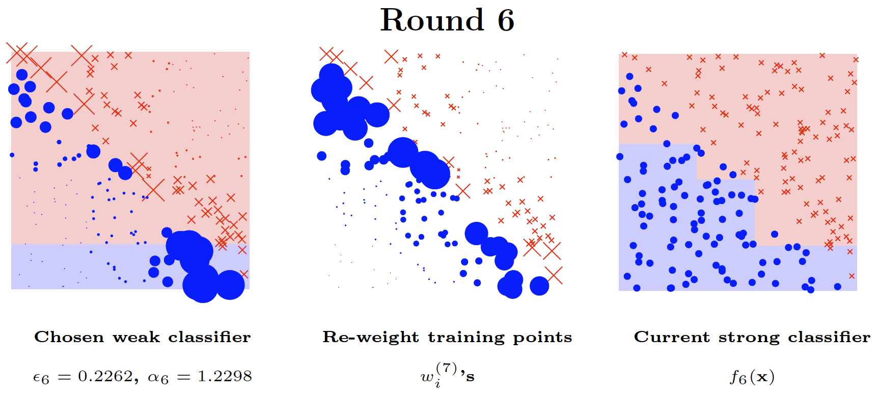
AdaBoost Visual Example

Slide 92
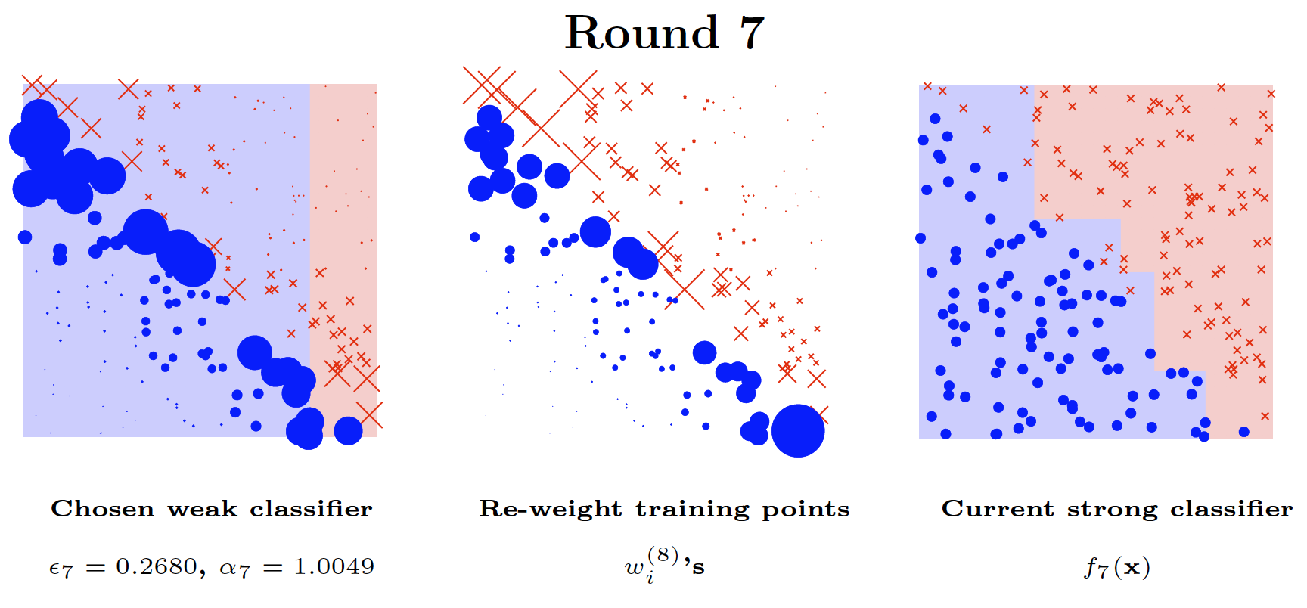
AdaBoost Visual Example

Slide 93
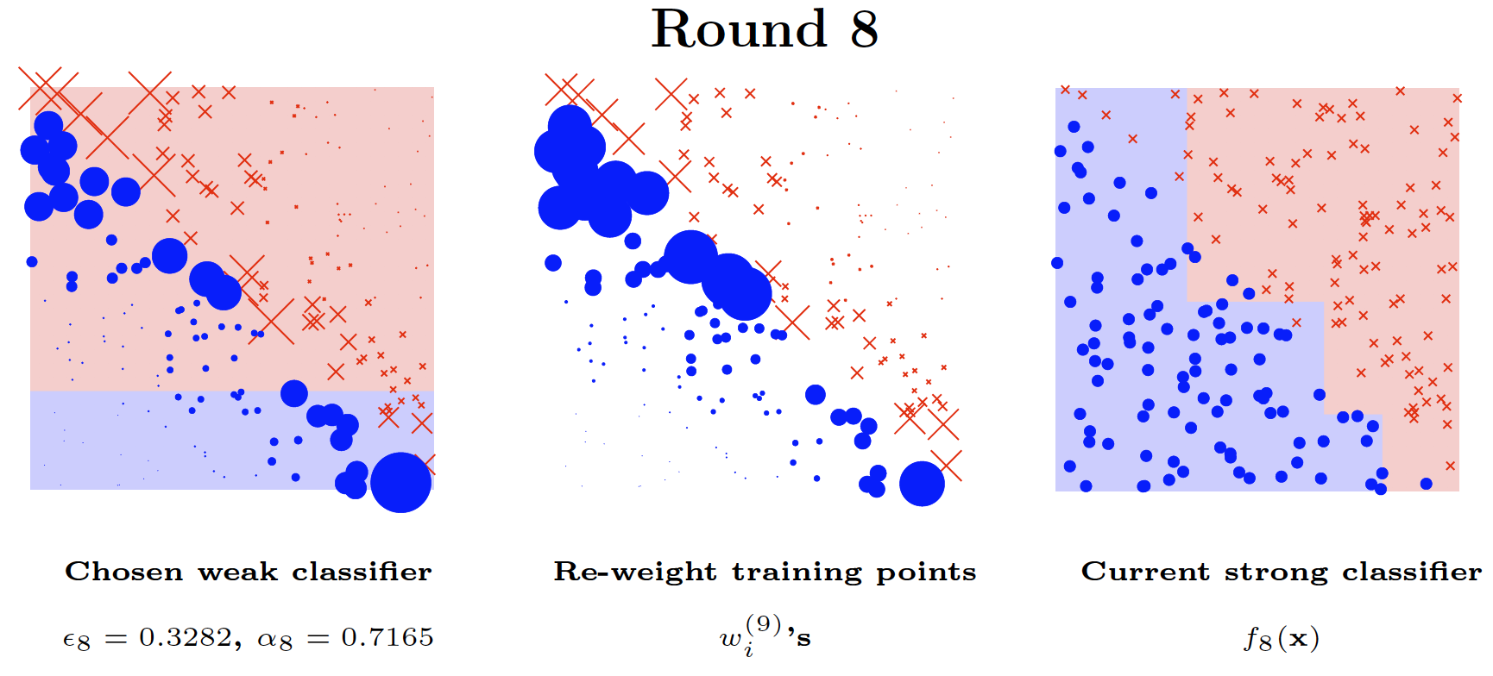
AdaBoost Visual Example

Slide 94
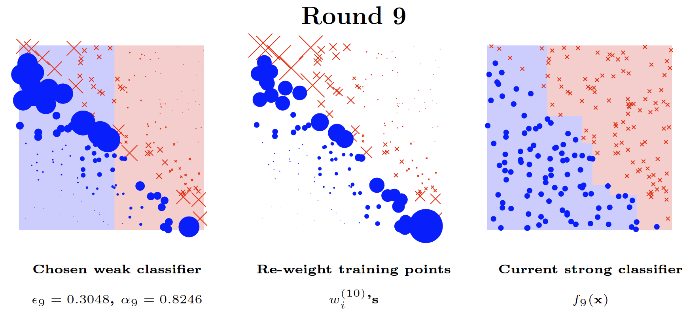
AdaBoost Visual Example

Slide 95
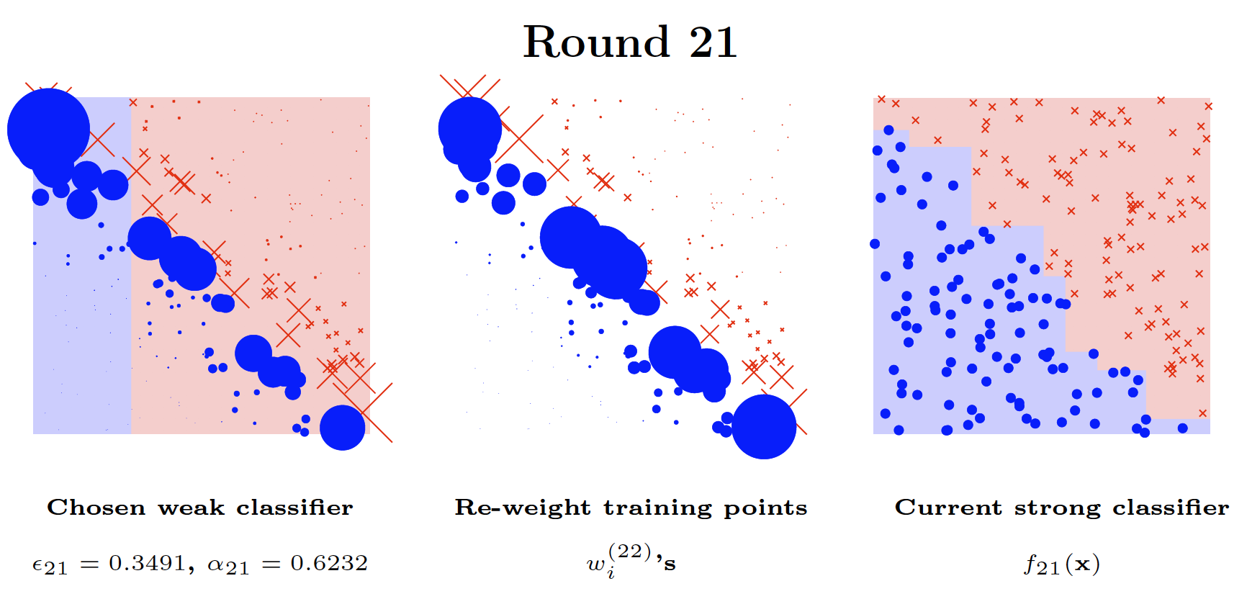
AdaBoost Visual Example

Slide 96
References
Ensemble Methods. Chapter 5.6. Introduction to Data Mining.

Slide 97
References
Chapter 3. Classification: Basic Concepts and Techniques.

